Slide 1
Atomic Developer Bundle
Containerized Development Made Easy
CentOS Dojo Brussels - January 2016
Brian “bex” Exelbierd (@bexelbie)
Navid Shaikh (@swordphilic)

Slide 2

Problem Statement
Linux Container Development
Group wants uniform stable development environment
Developers want personalized environment
Developers should “develop” not “configure”
Developer machines may not even run the technology
Current tools are not use case specific
Photo:By Dakota Lynch (Own work) [CC BY-SA 3.0 (http://creativecommons.org/licenses/by-sa/3.0)], via Wikimedia Commons
https://en.wikipedia.org/wiki/Snowflake#/media/File:Snow_Flakes.jpg

Slide 3
Solution - The Atomic Developer Bundle (ADB)
Platform independant development environment
Windows, OS X, Linux
Preconfigured tools that are good mimics of production
Multiple orchestrators (Docker, Kubernetes, OpenShift, Mesos-Marathon, …)
Extensible
No required stack
Nulecule Specification
Developer environment independent (keep on truckin')
3 distinct use cases
Command Line Carl
IDE Igor
My Environment Mike

Slide 4
Demo Time
"Command Line Carl" wants a command prompt. He doesn't want the rest. His company/wife/budget gave him a box that doesn't run docker or he doesn't want to pollute his 'email layer.'

Slide 5
Demo Time
"Command Line Carl" wants a command prompt. He doesn't want the rest. His company/wife/budget gave him a box that doesn't run docker or he doesn't want to pollute his 'email layer.'
"IDE Igor" has always used an IDE. He wants to do containers on his terms.

Slide 6
Demo Time
"Command Line Carl" wants a command prompt. He doesn't want the rest. His company/wife/budget gave him a box that doesn't run docker or he doesn't want to pollute his 'email layer.'
"IDE Igor" has always used an IDE. He wants to do containers on his terms.
"My Environment Mike" has his own box that he has tricked out to his liking. Mike wants to have his environment connect seamlessly with the dev tools and for them to stay out of the way.

Slide 7
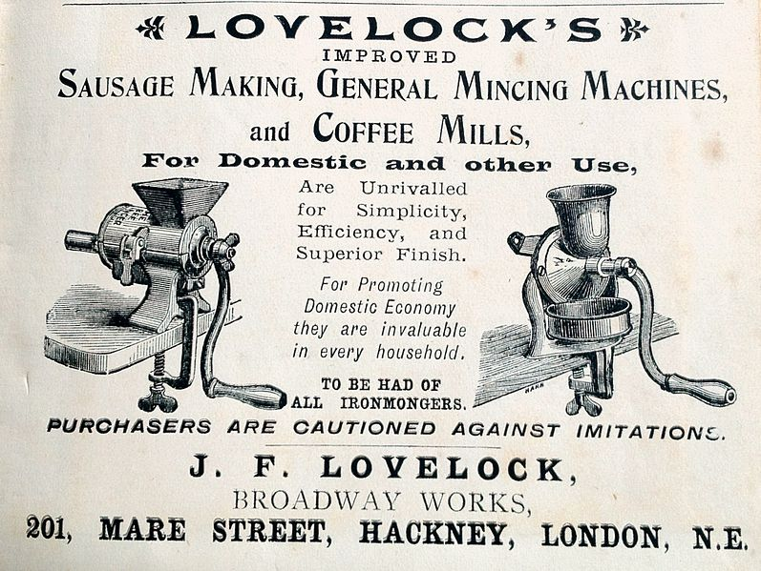
How Do We Make the sausage?
Vagrant Box
VirtualBox & libvirt
Utility scripts and configurations for multiple orchestrators
Vagrant Plugin
CentOS 7
CentOS Build System
Photo: By Schnäggli (Own work) [CC BY-SA 3.0 (http://creativecommons.org/licenses/by-sa/3.0)], via Wikimedia Commons https://commons.wikimedia.org/wiki/File:Sausage.making_J.F.Lovelocks.JPG

Slide 8
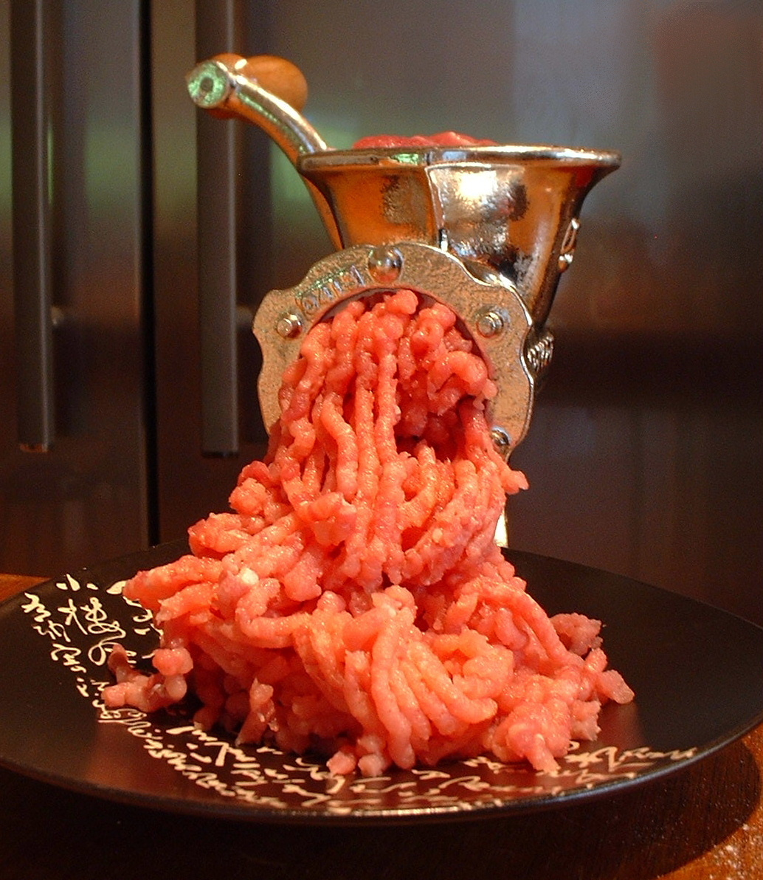
What’s the Sausage Made Of?
TLS protected docker daemon
Kubernetes
OpenShift
Mesos-Marathon
Atomic CLI
By FotoosVanRobin from Netherlands (My New Porkert #5 Meat Mincer) [CC BY-SA 2.0 (http://creativecommons.org/licenses/by-sa/2.0)], via Wikimedia Commons https://commons.wikimedia.org/wiki/File%3AA_Meat_Mincer.jpg

Slide 9
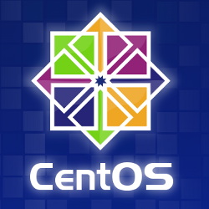
Why We Love CentOS
Stability
Community of Users
Special Interest Group (SIGs) for users and specific software versions
Build System
CI/CD System
Release cadence

Slide 10
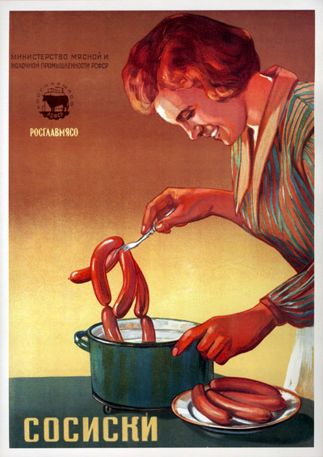
Sausage, It’s What’s For Dinner!
cloud.centos.org or via vagrant
$ vagrant init projectatomic/adb
$ vagrant up
$ vagrant plugin install vagrant-adbinfo
$ vagrant adbinfo
Client CLIs Available Upstream
docker
kubernetes
OpenShift
Note: Under VirtualBox you need to enable a public network interface - see the Usage Docs @ GitHub
Photo: http://www.darkroastedblend.com/2008/07/russian-vintage-advertising-posters.html

Slide 11

ADB Development & Contribution
Project repositories under projectatomic organization
https://github.com/projectatomic/
Mailing lists
https://www.redhat.com/mailman/listinfo/container-tools
IRC:
#nulecule and #atomic on Freenode
Public Meetings
Every Wed at 1230 UTC in a Bluejeans Video Conference
IRC meeting on #nulecule every Monday 1500 UTC
Photo: By Paul Stahr (1883–1953) [Public domain], via Wikimedia Commons
https://commons.wikimedia.org/wiki/File%3AColumbiaStahrArtwork.jpg

Slide 12
“The Future’s So Bright, I Gotta Wear Shades”
Future Ideas
more hypervisors
more orchestrators
service architecture and improved management via vagrant plugin
Today’s Challenges
TLS certificates generation for docker daemon
new vagrant plugin architecture
docker image caching
folder sync, sshfs?
DNS under Windows - ruby forks :(

Slide 13

Photo: http://www.shutterstock.com/pic.mhtml?id=193806773&src=id

Slide 14
Thank you!
Slides and Video will be at: https://wiki.centos.org/Events/Dojo/Brussels2016
Demos at: https://github.com/navidshaikh/centos_dojo_brussels_2016
References:
http://www.projectatomic.io/
https://github.com/projectatomic/adb-atomic-developer-bundle/
https://github.com/projectatomic/vagrant-adbinfo
https://www.centos.org/
Navid Shaikh (@swordphilic) Brian “bex” Exelbierd (@bexelbie)

